Slide 1
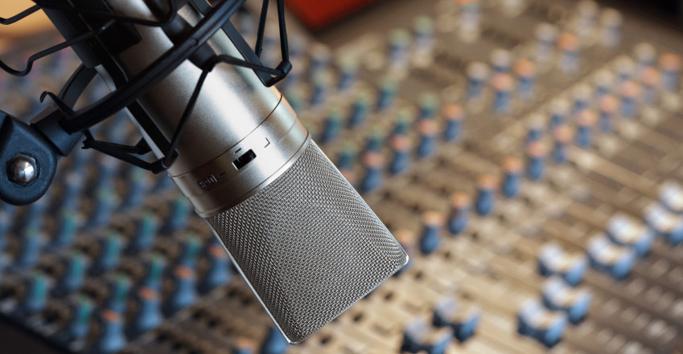

Mo’ Signal Mo’ Betta
MULTI-MICROPHONE DENOISING
Karl Ni

Slide 2
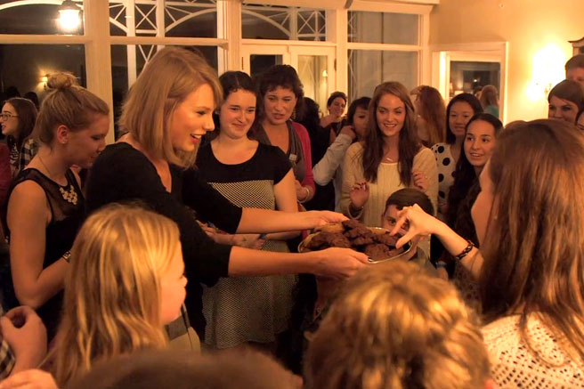
Notes:
Your house sitter had a party while you were gone and someone broke your vase!
Luckily, you’ve placed a lot of microphones around in the room.
You were in a hurry, though, and just threw them out there.
Keypoint: distribute microphones arbitrarily.

Slide 3
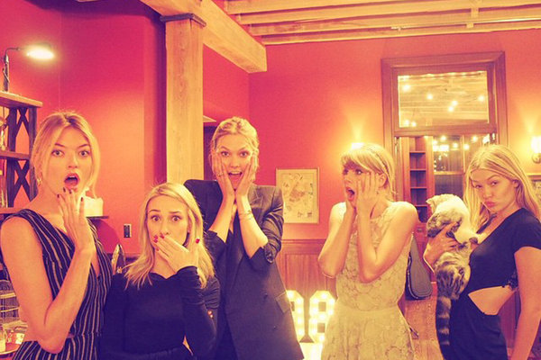
Notes:
2 Things:
- How many people at this party?
- Who broke your vase?

Slide 4

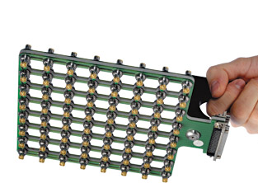




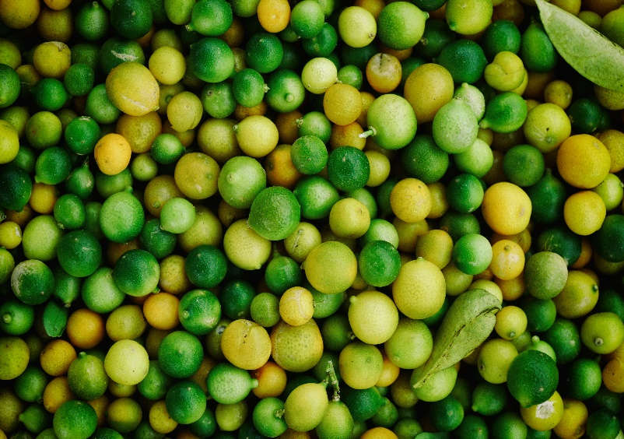

HOW IS THIS DONE TODAY?
RELATED WORK
SINGLE SENSOR
SENSOR ARRAY
DSP-BASED
HIGH ERROR RATES
PROBLEM UNSOLVED
HIGHLY CALIBRATED
KNOWN SENSOR PLACEMENT
SYNCHRONIZED TIMING
POOR COVERAGE
NONLINEAR EFFECTS
Notes:
Timeline slide

Slide 5


Relevance
IMPACT AND COLLABORATION AREAS
Mission Impact:
PAG: Quick sensor placement & reliable data recovery
Cheap COTS alternative that is simple and works
Group of three CIA: Transcription, Speaker ID, Annotation
Economic
Operational
Community & Lab Impact:
Ask:
10 Microphones: $40 each
Four man months for off-site experimentation
Notes:
Timeline slide

Slide 6






EMAIL
kni@iqt.org
PHONE
650-690-5347
WEBSITE
www.lab41.org
BLOG
www.lab41.org/gab41
Notes:
Contact slide. Feel free to change to suit your needs

Slide 10


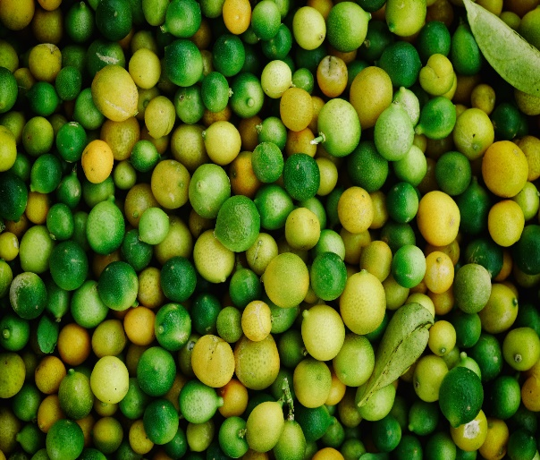

Approach
SUBTITLE FOR SLIDE
01.
Thing One
02.
Thing Two
03.
Thing Three
04.
Thing Four
Here is some more information about thing 1. Make sure it is interesting text.
Here is some more information about thing 2. Make sure it is interesting text.
Here is some more information about thing 3. Make sure it is interesting text.
Here is some more information about thing 4. Make sure it is interesting text.
Notes:
Timeline slide

Slide 11
FOUR THINGS
SUBTITLE FOR SLIDE
THING ONE
THING THREE
Here’s some more stuff about Thing One. This is really interesting and informative. I hope you like it. I think it is cool.
Here’s some more stuff about Thing Three. This is really interesting and informative. I hope you like it. I think it is cool.
THING TWO
THING FOUR
Here’s some more stuff about Thing Two. This is really interesting and informative. I hope you like it. I think it is cool.
Here’s some more stuff about Thing Four. This is really interesting and informative. I hope you like it. I think it is cool.
Notes:
Timeline slide

Slide 12

CUSTOMER STATEMENT
SUBTITLE FOR SLIDE
“The path of the righteous man is beset on all sides by the inequities of the selfish and tyranny of evil men. Blessed is he who, in the name of charity and good will, shepherds the weak through the valley of darkness.”
Notes:
Timeline slide

Slide 13
LINE GRAPH EXAMPLE
SUBTITLE FOR SLIDE
ANALYSIS ONE
Explain something meaningful about your bar chart. If you can manage to have the color of this section match the bar chart, more power to you!
ANALYSIS TWO
Explain something meaningful about your bar chart. If you can manage to have the color of this section match the bar chart, more power to you!
ANALYSIS THREE
Explain something meaningful about your bar chart. If you can manage to have the color of this section match the bar chart, more power to you!
Notes:
An example of a line graph powerpoint slide.
This should be as complex a chart as you show your audience. A good way to enforce discipline is by actually making your bar chart in Powerpoint (instead of importing something from Excel).
The crappy user interface that Powerpoint provides to create a new chart will naturally make you try to present less data.

Slide 14
BAR GRAPH EXAMPLE
SUBTITLE FOR SLIDE
ANALYSIS ONE
Explain something meaningful about your bar chart. If you can manage to have the color of this section match the bar chart, more power to you!
ANALYSIS TWO
Explain something meaningful about your bar chart. If you can manage to have the color of this section match the bar chart, more power to you!
ANALYSIS THREE
Explain something meaningful about your bar chart. If you can manage to have the color of this section match the bar chart, more power to you!
Notes:
An example of a bar graph powerpoint slide.
This should be as complex a chart as you show your audience. A good way to enforce discipline is by actually making your bar chart in Powerpoint (instead of importing something from Excel).
The crappy user interface that Powerpoint provides to create a new chart will naturally make you try to present less data.

Slide 15
EMAIL
info@lab41.org
PHONE
650-234-8999
WEBSITE
www.lab41.org
BLOG
www.lab41.org/gab41
Notes:
Contact slide. Feel free to change to suit your needs

Slide 16

IMPORTANT STATEMENT
Blue filter full-page photo slide.
Use this space to say something more on this slide
Notes:
Full page photo slide.
To change the photo, just grab the blue rectangle and move it to the side. Then select the photo underneath (which is a picture fill rectangle) and click on Shape Fill and select Image.

Slide 17
IMPORTANT STATEMENT
Red filter full-page photo slide.
Use this space to say something more on this slide
Notes:
Full page photo slide.
To change the photo, just grab the blue rectangle and move it to the side. Then select the photo underneath (which is a picture fill rectangle) and click on Shape Fill and select Image.

Slide 18
IMPORTANT STATEMENT
Grey filter full-page photo slide.
Use this space to say something more on this slide
Notes:
Full page photo slide.
To change the photo, just grab the blue rectangle and move it to the side. Then select the photo underneath (which is a picture fill rectangle) and click on Shape Fill and select Image.

Slide 19
IMPORTANT STATEMENT
Notes:
Full page photo slide.
To change the photo, Select the photo underneath (which is a picture fill rectangle) and click on Shape Fill and select Image.

Slide 20
IMPORTANT STATEMENT
Notes:
Full page photo slide.
To change the photo, Select the photo underneath (which is a picture fill rectangle) and click on Shape Fill and select Image.

Slide 21
IMPORTANT STATEMENT
Notes:
Full page photo slide.
To change the photo, Select the photo underneath (which is a picture fill rectangle) and click on Shape Fill and select Image.

Slide 22
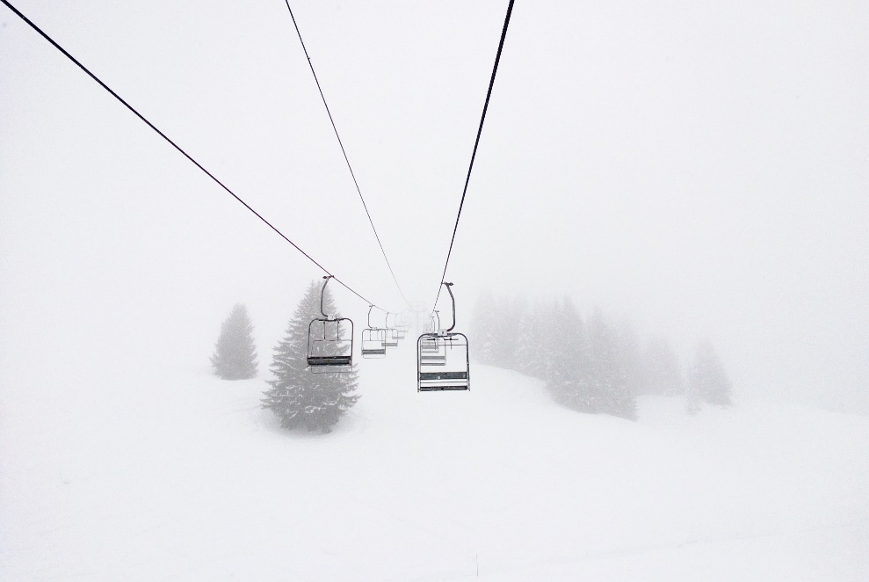
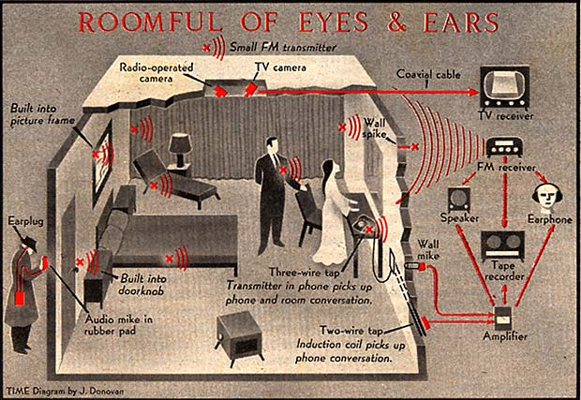
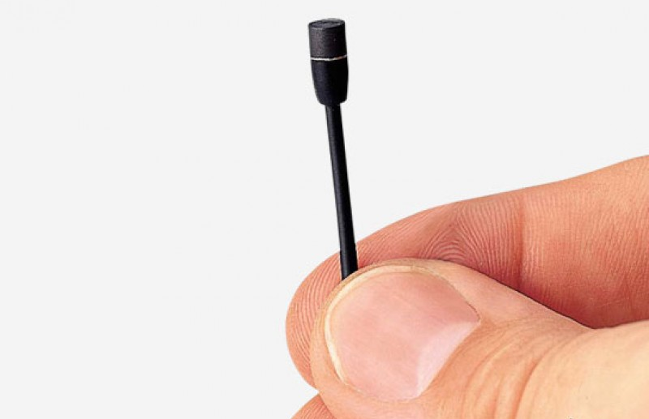
WHAT DO YOU WANT TO FIND OUT?
PROBLEM STATEMENT
Customer Problem
Speakers can be placed anywhere.
Coverage is important.
Diverse types of rooms.
How many people are speaking?
Denoise each speaker
1
2
Notes:
For each speaker, denoise them
To be able to hear each speaker better
Afterward, it’s possible to do more processing

Slide 23




GENERAL AND SPECIFIC APPROACH
USE MULTIPLE MICROPHONES TO ISOLATE AND DENOISE SPEAKERS
SPECIFIC APPROACH
CHALLENGES
Speaker Isolation
Intrinsic Challenges
TDOA speaker identification
Microphone polarization
Timing skew
Speech Filtering
Environmental Problems
Denoising neural networks
Variable noise floor
Attenuation
Multipath
Notes:
Formal problem (technical name): Acoustic beamforming with arbitrary microphone placement
Deep audio peak finding for TDOA
Speech filtering w/denoising NN’s
Joint learning of speaker IDs and cleaned signal
Challenges:
Internal challenges:
Microphone polarization and timing
External challenges:
High noise floor and attenuation
Multipath: may be in an anechoic chamber or you might be at Carnegie hall

